Slide 1
CCNP Enterprise: Core Networking (ENCOR) and CCNP Enterprise: Advanced Routing (ENARSI)
Product Overview
Updated April 2020

Slide 2
CCNP Enterprise Version 8.0
Curriculum Overview
Course Designs
Assessments
Certification & Exam Alignment
Lab Equipment
Logistics

Slide 3



CCNP Version 8 Will Be The Best Yet!
Enhanced Course Design
Improved Assessments
Certification Alignment

Slide 4

CCNP Enterprise Curriculum
Curriculum Overview
Career Prep
Learning Components
The two courses in this CCNP Enterprise version 8.0 curriculum provide students with knowledge and skills needed to configure, operate and troubleshoot large scale enterprise networks. The courses cover a broad range of routing, switching and wireless topics along with security best practices used in software-driven digital networks.
By the end of the CCNP course series, students gain practical, hands-on experience preparing them for the CCNP Enterprise certification exams and career-ready skills for professional-level roles in the Information & Communication Technologies (ICT) industry.
Series of 2 courses:
CCNP Enterprise: Core Networking (ENCOR)
CCNP Enterprise: Advanced Routing (ENARSI)
Hands-on labs and optional Cisco Packet Tracer network simulation activities
Videos and quizzes reinforce learning
Exams to measure learning outcomes
Assessment features to improve exam security
Features
Certification
Aligned
Target Audience: Students interested in pursuing a career as a Network Engineer or Systems Engineer
Prerequisites: None required but CCNA level knowledge is needed for success
Course Delivery: Instructor-led
Estimated Time to Complete: 140 hours total (70 hours per course)
Recommended Next Course: Broaden skills with DevNet Associate, CyberOps Associate, Python or Emerging Tech Workshops

Slide 5

CCNP Enterprise: Core Networking (ENCOR)
Course Overview
This first course in the 2-course CCNP Enterprise series covers switching, routing, wireless, and related security topics, along with the technologies that support software-defined, programmable networks.
Benefits
This course directly prepares for the Cisco Enterprise Network Core Technologies exam (350-401 ENCOR) to earn an Enterprise Core Specialist certification.
Completion of both courses in the CCNP Enterprise course series prepares for the CCNP Enterprise certification exam.
Features
Target Audience: Secondary vocational students, 2-year and 4-year college students in Networking or Engineering
Recommended Preparation; CCNA or equivalent knowledge & skills
Instructor Training Required: Yes
Languages: English
Course Delivery: Instructor-led
Course Recognitions: Certificate of Completion, Letter of Merit, Digital Badge
Estimated Time to Complete: 70 hours
Recommended Next Course: CCNP Enterprise: Advanced Routing (ENARSI)
Learning Components
29 chapters
41 hands-on labs
24 Packet Tracer activities (optional)
7 videos
29 Chapter quizzes
11 Chapter-Group exams
1 Final exam
1 practice certification exam

Slide 6
CCNP Enterprise: Advanced Routing (ENARSI)
Course Overview
This second of the 2-course CCNP Enterprise series focuses on implementation and troubleshooting of advanced routing and redistribution for OSPF, EIGRP and BGP along with VPN technologies, infrastructure security and management tools used in Enterprise networks.
Benefits
This course directly prepares for the Cisco Enterprise Advanced Routing and Services concentration exam (300-410) to earn the Enterprise Advanced Infrastructure Implementation Specialist certification.
By also passing the core exam (350-401 ENCOR) you will earn the CCNP Enterprise certification.
Features
Target Audience: Secondary vocational students, 2-year and 4-year college students in Networking or Engineering
Recommended Preparation; CCNP Enterprise: Core Networking or equivalent knowledge & skills
Instructor Training Required: Yes
Languages: English
Course Delivery: Instructor-led
Course Recognitions: Certificate of Completion, Letter of Merit, Digital Badge
Estimated Time to Complete: 70 hours
Learning Components
23 chapters
40 hands-on labs
20 Packet Tracer activities (optional)
2 videos
23 Chapter quizzes
6 Chapter-Group exams
1 Final exam
2 Skills assessments
1 practice certification exam

Slide 7
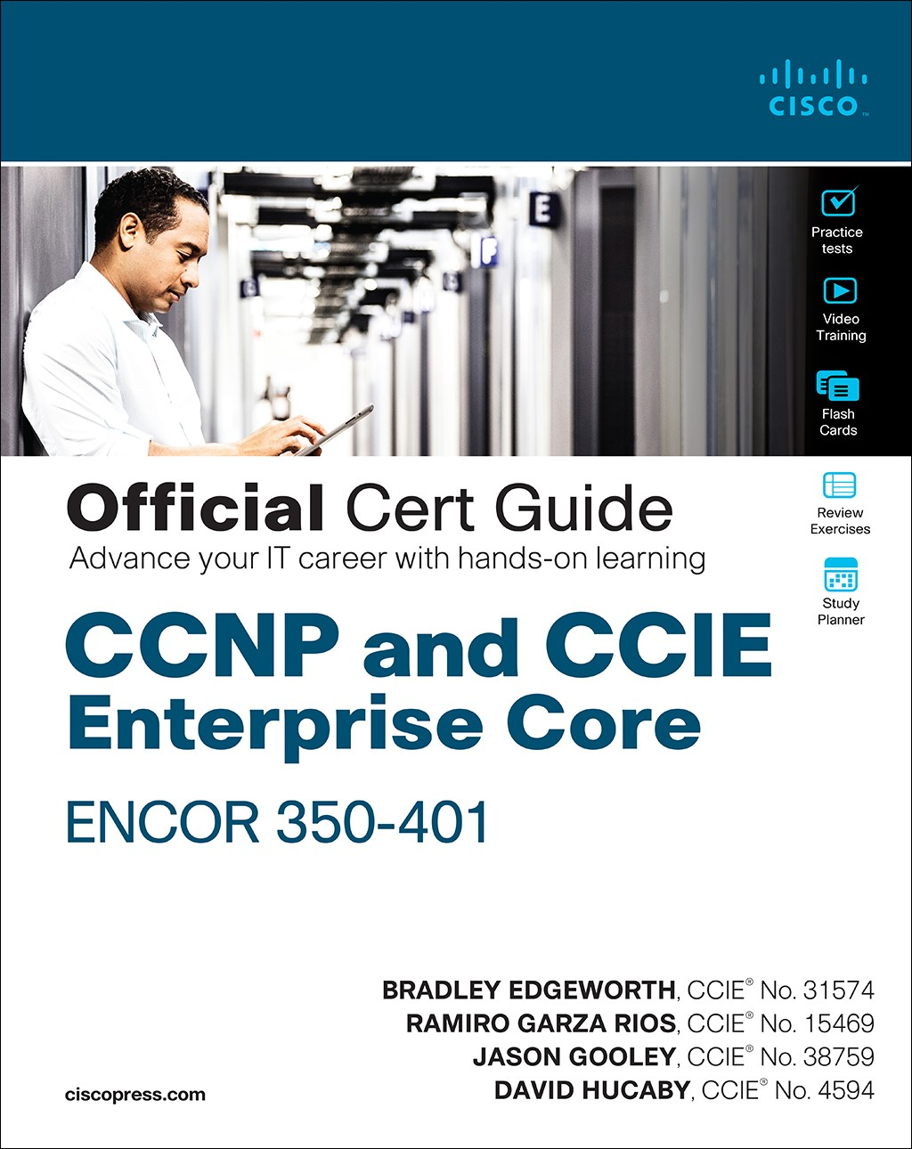
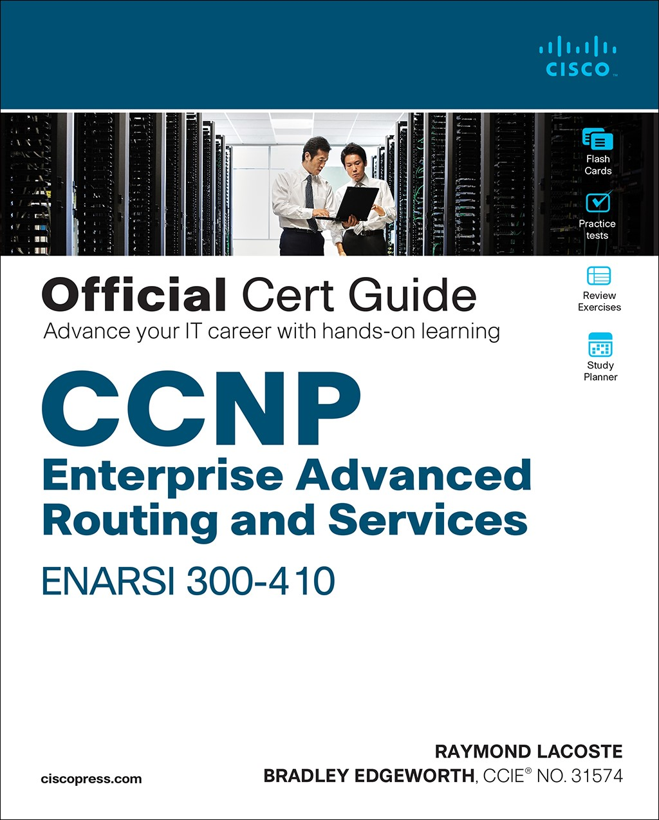
Course Content
Both courses require the Cisco Press Official Cert Guide as student textbook
Certification Guide
Available in book and e-Book formats
Book
ISBN-10: 1-58714-523-5
ISBN-13: 978-1-58714-523-0
Certification Guide
Available in book and e-Book formats
Book
ISBN-10: 1-58714-525-1
ISBN-13: 978-1-58714-525-4

Slide 8
Enhanced Course Design
Expand
Learning Effectiveness
Designed for skills progression
Better student engagement
Improved user experience
Expose
Apply
Practice
New! Quizzes, chapter-group exams, and secure final exam
New! Videos for topics not covered in labs
New! Labs, assessments and videos embedded within new UI for improved student experience
New! Optional Packet Tracer activities for further skill-building and practice

Slide 9
Enhanced Course Design
Improved Outcomes
Build hands-on skills
Additional preparation for certification exams
New! Certification practice exam
New! Virtual Machine lab to practice network programmability
New! Final exam and hands-on skills assessment
New! Ability to earn a Cisco digital learning credential (70% min score on 1st attempt of final)

Slide 10

Chapter-Group Assessment Mapping
Improved Assessments
ENCOR Chapter Group Assessment Mapping
Chapter |  | Chapter-Group Assessments
1 | Packet Forwarding | L2 Redundancy
2 | Spanning Tree Protocol
3 | Advanced Spanning Tree
4 | Multiple Spanning Tree Protocol
5 | VLAN Trunks and EtherChannel Bundles
6 | IP Routing Essentials | Routing Essentials and EIGRP
7 | EIGRP
8 | OSPF | OSPF
9 | Advanced OSPF
10 | OSPRv3
11 | BGP | BGP
12 | Advanced BGP
13 | Multicast | Multicast and QoS
14 | QoS
15 | IP Services | IP Services and VPNs
16 | Overlay Tunnels
Chapter |  | Chapter-Group Assessments
17 | Wireless Signals and Modulation | Wireless Essentials
18 | Wireless Architecture Infrastructure
19 | Understanding Wireless Roaming and Location Services
20 | Wireless Security Authenticating Wireless Clients | Wireless Security and Connectivity
21 | Wireless Troubleshooting Troubleshooting Wireless Connectivity
22 | Enterprise Network Architecture | Network Design and Monitoring
23 | Fabric SDN Technologies
24 | Network Assurance
25 | Secure Access Control | Access Control and Infrastructure Security
26 | Network Device Access Control and Infrastructure Security
27 | Virtualization | Virtualization, Automation, and Programmability
28 | Foundational Network Programmability Concepts
29 | Introduction to Automation Tools

Slide 11
Chapter-Group Assessment Mapping
Improved Assessments
ENARSI Chapter Group Assessment Mapping
Chapter |  | Chapter-Group Assessments
1 | IPv4 and IPv6 Addressing and Routing Review | Routing Concepts and EIGRP
2 | EIGRP
3 | Advanced EIGRP
4 | Troubleshooting EIGRP
5 | EIGRPv6
6 | OSPF | OSPF
7 | Advanced OSPF Configuration
8 | Troubleshooting OSPFv2
9 | OSPFv3
10 | Troubleshooting OSPFv3 and Address Families
11 | BGP | BGP
12 | Advanced BGP
13 | BGP Best Path Selection
14 | Troubleshooting BGP
Chapter |  | Chapter-Group Assessments
15 | Route Maps and Policy Based Routing | Conditional Forwarding and Route Redistribution
16 | Redistribution
17 | Troubleshooting Redistribution
18 | VRFs, MPLS and MPLS Layer 3 VPNs | VPNs
19 | Dynamic Multipoint VPN
20 | Securing DMVPN Tunnels
21 | Troubleshooting IPv4 and IPv6 ACLs and Prefix Lists | Infrastructure Security and Management
22 | Infrastructure Security
23 | Device Management and Management Tools Troubleshooting

Slide 12
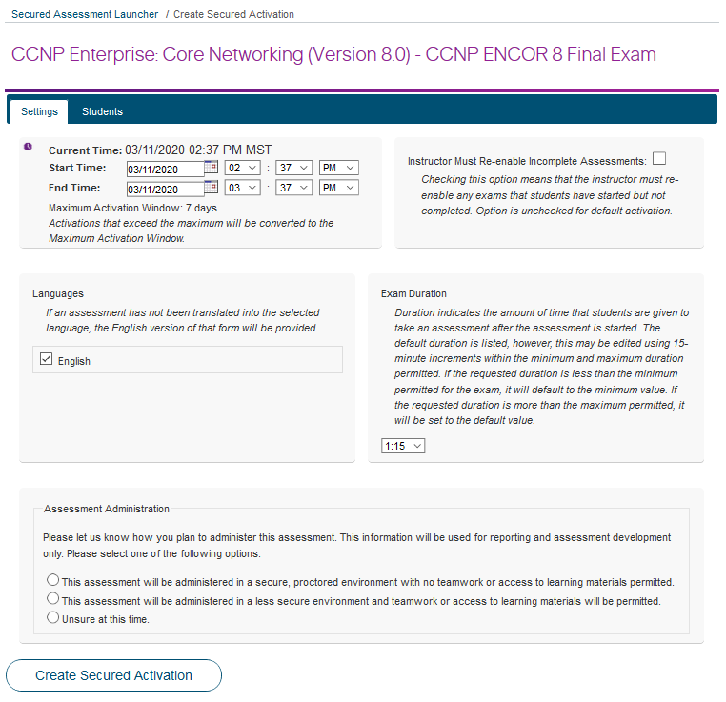
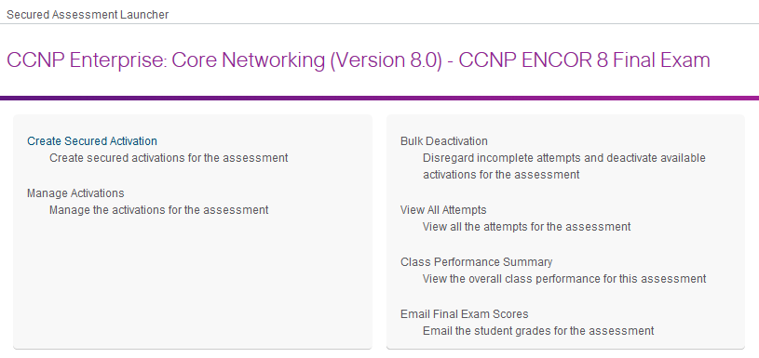
Improved Assessments
Secured Activation increases final exam security
New Assessment Launcher
Final exams remain secure until administered by instructor
Replaces the Assessment Viewer
For security & integrity, questions are not visible

Slide 13
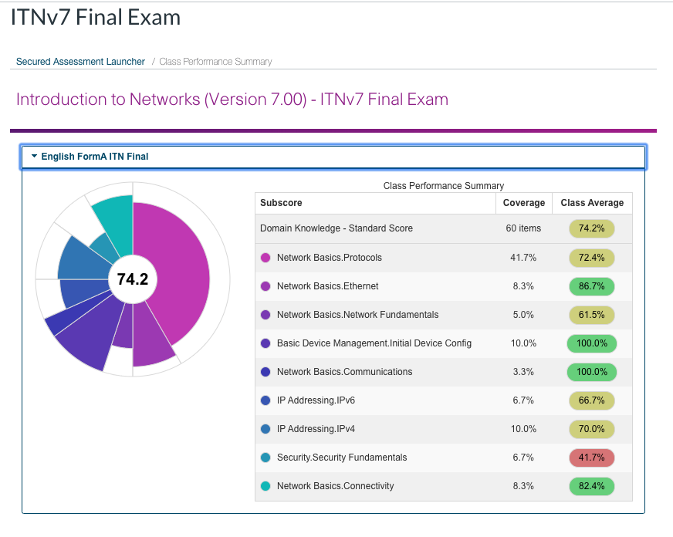
Improved Assessments
Secured Activation provides useful insights on class performance
Domain Level Reporting
New Class Performance Summary report for instructors
Replaces the Student Performance Summary
See how your students are performing in each domain based on objectives of the modules and course

Slide 14
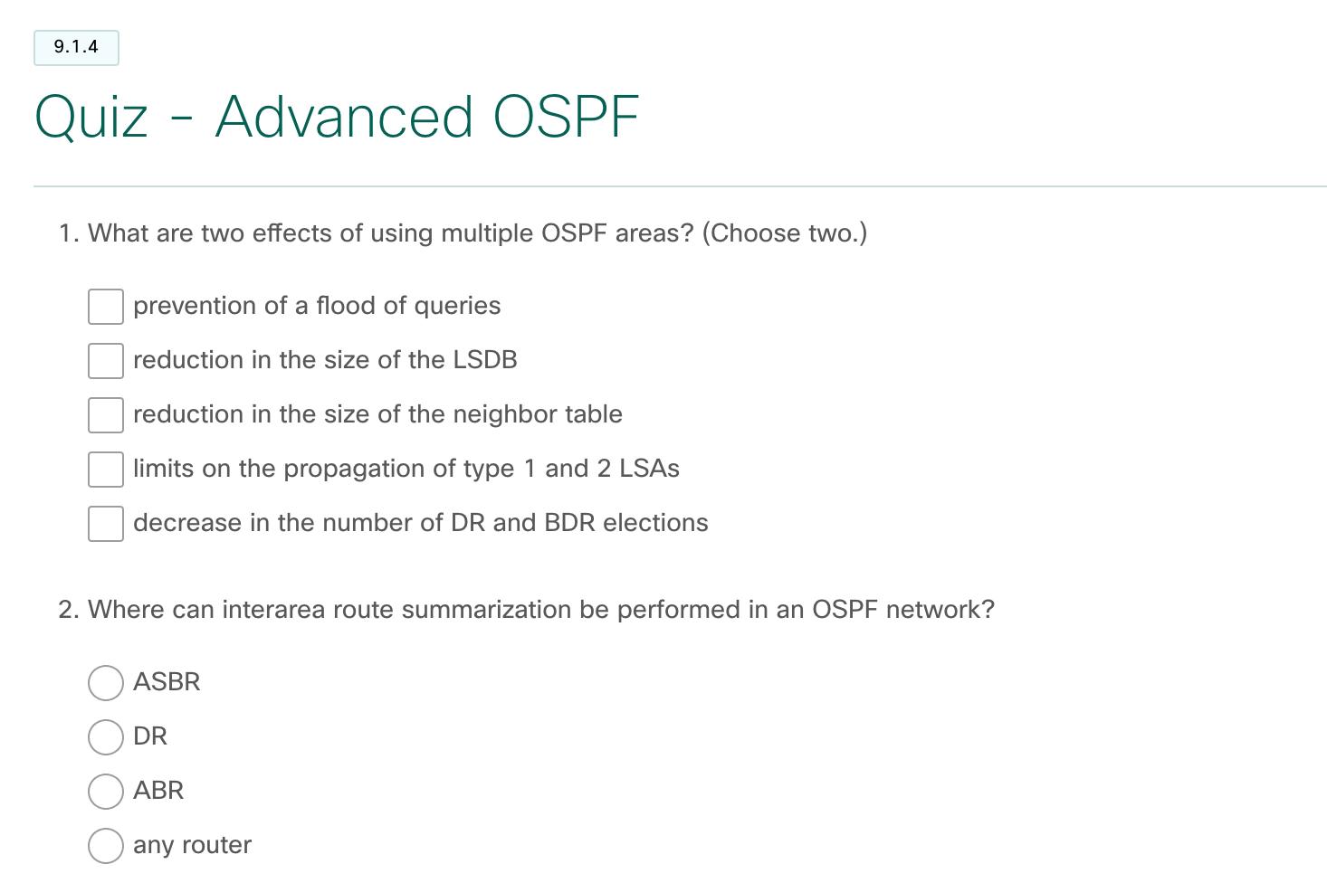
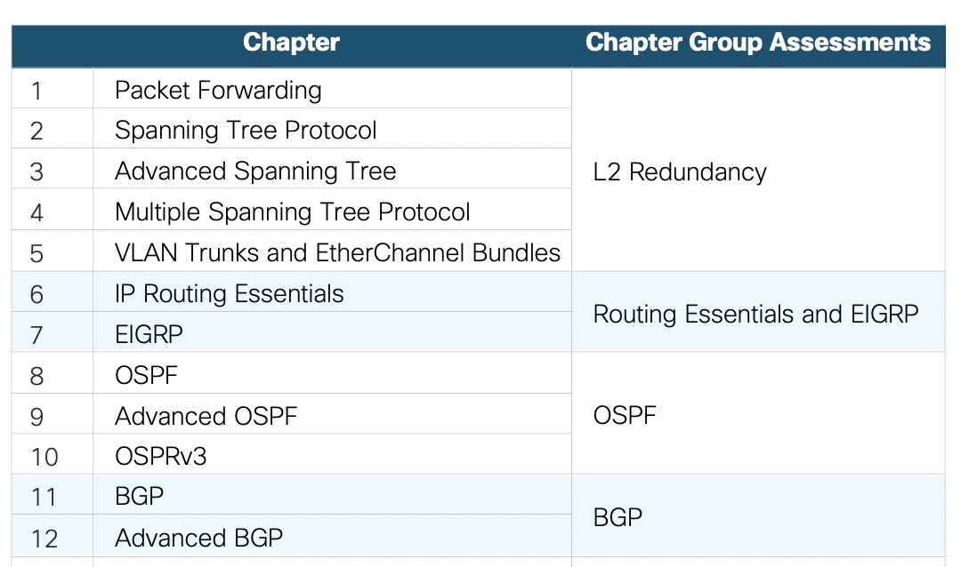
Improved Assessments
Formative and Summative Assessments guide learning at strategic points
Self-Assessments
Launched by Instructor
Check Your Understanding Quizzes
1 per chapter
Correct/incorrect scoring and ‘show me’ option
Chapter Group Exams*
Multiple per course
Final Exams*
1 per course
Certification Practice Exams
1 per course
*Exams use dynamic forms with some variation in items

Slide 15

Certification & Exam Alignment
Cisco has evolved to a new CCNP Enterprise certification streamlined to require passing two exams
The Enterprise Core exam (350-401) tests a candidate's knowledge of implementing core enterprise network technologies including dual stack architecture, virtualization, infrastructure, network assurance, security and automation and earns a Cisco Specialist certification for Enterprise Core
The Enterprise Advanced Routing and Services exam (300-410) tests a candidate's knowledge for implementation and troubleshooting of advanced routing technologies and services including Layer 3, VPN services, infrastructure security, infrastructure services, and infrastructure automation and earns a Cisco Specialist certification for Enterprise Advanced Infrastructure Implementation
Passing both exams earns a CCNP Enterprise certification
Certification
Alignment
Professional Level
Core Exam
Concentration Exam
Enterprise
Advanced Routing & Services
Enterprise Core
+

Slide 16

Lab Equipment

Slide 17


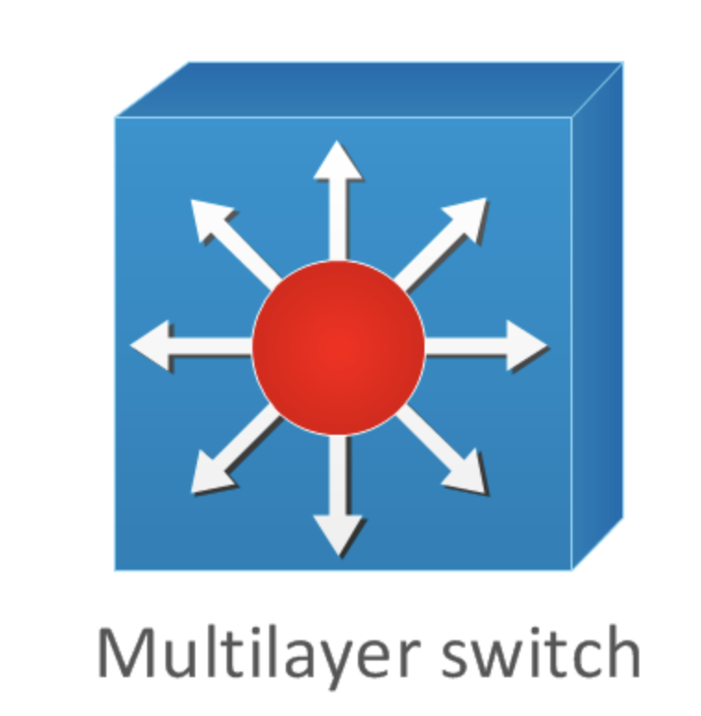


CCNP Enterprise 8.0 – Lab Equipment
CCNP R&S 7
CCNP Enterprise 8.0
4221
For CCNP Enterprise 8.0:
NIM-2T Serial ports needed for 2 of 3 routers
Packet Tracer 7.3.0 or higher required for optional Packet Tracer activities
4221
1 less 4221
or 4321 or 4331
or 4321 or 4331
2960
2960
1 less 2960
3650
3650
Refer to posted CCNP Enterprise Equipment List
Server and End Devices
Server and End Devices

Slide 18
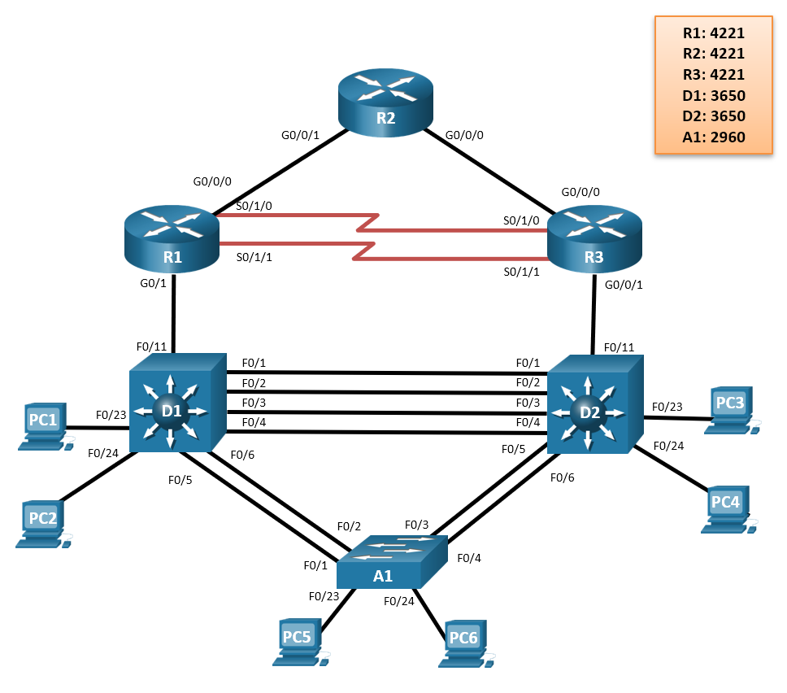
CCNP Enterprise 8.0 – Lab Topology
This is the same basic topology as used by CCNPv7.1;
Some connections are changed around, and there is one less 2960 L2 Switch and one less ISR4221
Most current labs can be adapted, and the LP labs can be used directly or adjusted for the topology
CCNP Baseline Equipment Recommendation
3x Cisco 4221 with SEC license (2 with NIM-2T)
2x Cisco Catalyst 3650 Switches (WS-C3650-24TS-E)
1x Cisco Catalyst 2960+ Switch (WS-C2960+24TC-L)
Ethernet cables as shown in the topology
2x CAB-SS-V35MT= (10’ DTE Serial Cable)
2x CAB-SS-V35FC= (10’ DCE Serial Cable)
Computers (Virtual or Physical)
Minimum 1x PC workstation host (Linux or Windows)
Minimum 1x PC server host (Linux or Windows)

Slide 19

Logistics

Slide 20
CCNP Enterprise 8.0 Instructor Qualification Mapping
CCNP R&S 7 Course Current Qualification(s) | CCNP Enterprise 8.0 Course Qualification(s) Earned | Materials to Review*
CCNP R&S ROUTE | CCNP Enterprise: Core Networking (ENCOR) | New topics
CCNP R&S SWITCH | N/A | None
CCNP R&S TSHOOT | CCNP Enterprise: Advanced Routing (ENARSI) | New topics
CCNP R&S ROUTE CCNP R&S SWITCH | CCNP Enterprise: Core Networking (ENCOR) | New topics
CCNP R&S SWITCH CCNP R&S TSHOOT | CCNP Enterprise: Advanced Routing (ENARSI) | New topics
CCNP R&S ROUTE CCNP R&S TSHOOT | CCNP Enterprise: Core Networking (ENCOR) CCNP Enterprise: Advanced Routing (ENARSI) | New topics
CCNP R&S ROUTE CCNP R&S SWITCH CCNP R&S TSHOOT | CCNP Enterprise: Core Networking (ENCOR) CCNP Enterprise: Advanced Routing (ENARSI) | New topics

Slide 21
CCNP Enterprise: Core Networking (ENCOR) Leveraged and Key New Topics
Leveraged course material
Key new topics
Wireless (RF, infrastructure, roaming, authenticating, troubleshooting)
Multicast (concepts, protocols)
Fabric technologies (SD-Access, SD-WAN)
Overlay tunnels (IPSec, VXLAN, LISP)
QoS (mechanisms, applications)
Security (network access control, threat defense, endpoint and infrastructure security)
Programmability concepts (APIs, data models, DevNet, GitHub, Python basics)
Virtualization concepts (NFV, VMs, virtual switching)
Automation tools (Embedded Event Manager, Agent and Agentless tools)
ROUTE
CCNP Enterprise: Core Networking (ENCOR)
SWITCH
TSHOOT
CCNA
Security
CCNA
R&S v6

Slide 22
CCNP Enterprise: Advanced Routing (ENARSI) Leveraged and Key New Topics
Leveraged course material
Key new topics
MPLS Layer 3 VPNs
Dynamic Multipoint VPN
DMVPN security
Advanced BGP
Troubleshooting IPv6 ACLs
Flexible Netflow
Troubleshooting CoPP
IPv6 First Hop Security
Cisco DNA Center Assurance
ROUTE
CCNP Enterprise: Advanced Routing (ENARSI)
TSHOOT
CCNA
Security

Slide 23
CCNP Route & Switch End of Life
Course(s) | Language * | Last Class Start Date
ROUTE, SWITCH and TSHOOT 7.1 courses | English | 4/30/21

Slide 24
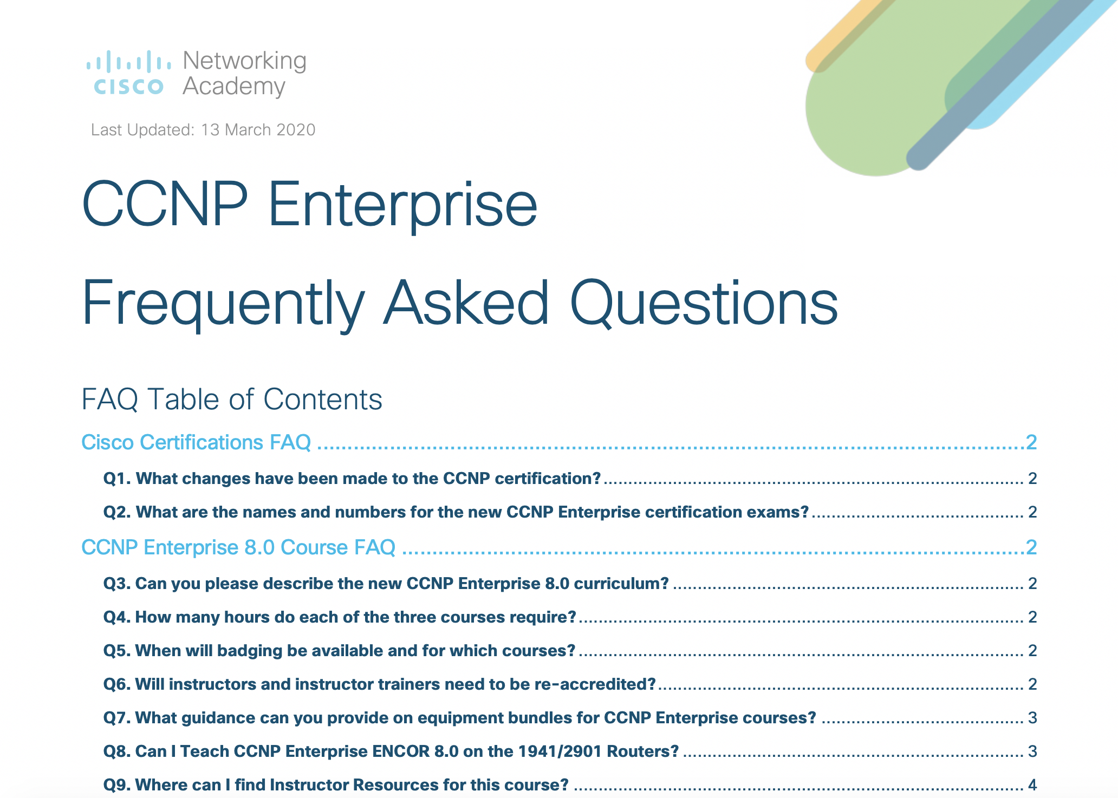
CCNP Enterprise Course Resources
Product Overview
Scope and Sequence
Release Notes
Instructor Planning Guides (includes Instructor PPTs)
Instructor Lab Source Files
Instructor Packet Tracer Source Files
Optional Packet Tracer Activity Source Files
Student Lab Source Files
Student Packet Tracer Source Files
Exam Design Documents
Access Course Resource Page through NetAcad.com
https://www.netacad.com/portal/resources/course-resources/ccnp-encor
https://www.netacad.com/portal/resources/course-resources/ccnp-enarsi

